Slide 1
Peer Community and Tax Review
Revenue options for FY 2025
Prepared for Scottsville Town Council Special Session, March 26, 2024

Slide 2
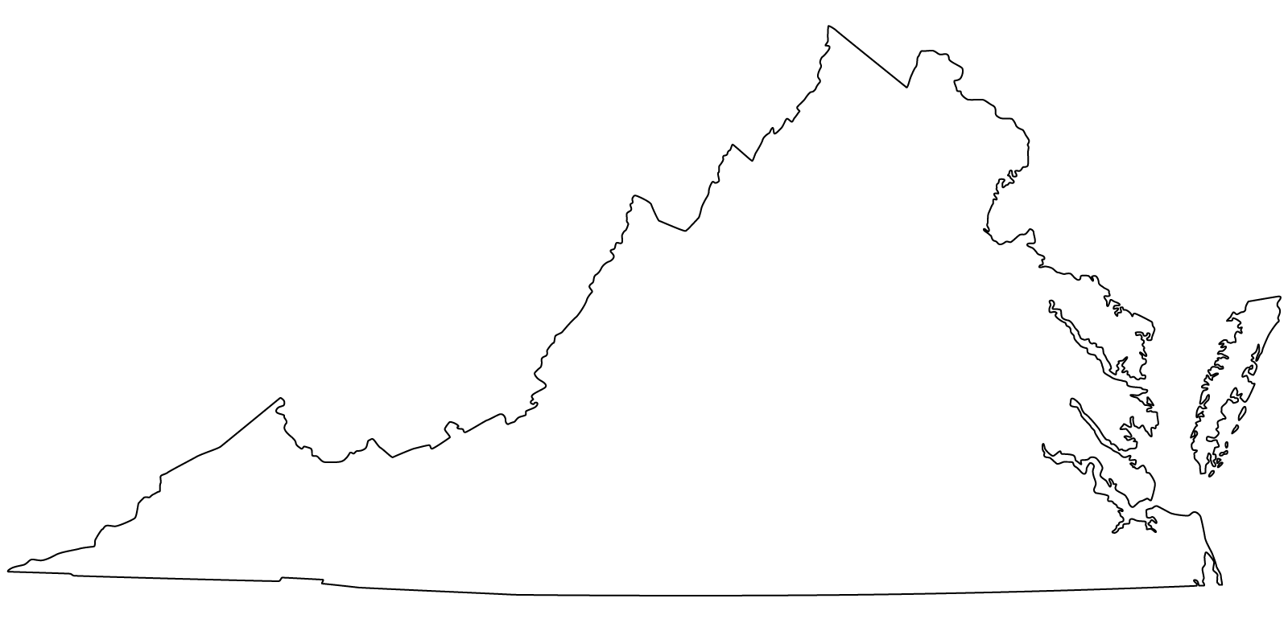
Scottsville Peer Communities Ascending by Population
Madison
Mineral
Hamilton
Jarratt
Remington
Round Hill
Damascus
Middleburg
Brookneal
Gordonsville
Louisa
6
3
8
2
5
10
11
1
9
4
7
SAMPLE SIZE REPRESENTS:
6% of towns in Virginia
11% of towns in population range (208-1987)
Notes:
https://en.wikipedia.org/wiki/List_of_towns_in_Virginia + Census
Census 2022 City/Town estimates of Pop.

Slide 3
Peer Community Comparison Population, Budget and Services
Town
Madison
Mineral
Scottsville
Hamilton
Jarratt
Remington
Round Hill
Damascus
Middleburg
Brookneal
Gordonsville
Louisa
Population
205
470
524
619
652
626
693
788
669
1090
1402
1987
FY24 Budget
$430,251
$1,276,684
$743,873
$2,771,763 (FY22)
$550,158
$544,751 (FY23)
$1,006,242 Op. (3M W&S)
$2,549,733
$4,990,437
$867,896 (.5M W&S)
$5,478,615 (3M W&S,Pool, etc.)
$4,920,000 (FY 23)
Municipal Services
DMV Select
Water & Sewer, DMV Sel.
Flood Control, Police Dept.
Water & Sewer
None
W&S, PD, Trash, DMV Sel.
Water & Sewer
W&S, Police Dept.
W&S, Police Dept.
W&S, Police Dept.
W&S, Police Dept.
W&S, Police Dept., Trash
Notes:
Source: 2020 Decennial census

Slide 4
Peer Community Comparison Revenue Tools
Town
BPOL
Meals Tax
Personal Property Tax
Real Estate Tax
Madison
Mineral
Scottsville
Hamilton
Jarratt
Remington
Round Hill
Damascus
Middleburg
Brookneal
Gordonsville
Louisa
✅
✅
✅
✅
✅
✅
✅
✅
✅
☐
✅
✅
✅
✅
✅
✅
✅
☐
☐
✅
✅
✅
✅
✅
☐
✅
☐
✅
✅
✅
✅
✅
☐
✅
✅
✅
✅
✅
☐
✅
✅
✅
✅
✅
✅
✅
✅
✅

Slide 5
Comparison FY 2020 Revenue Distribution Peer Community Survey

Slide 6
Comparison FY 2020 Revenue Distribution Peer Community Survey

Slide 7
Total Revenue FY 2023-2024= $755,200

Slide 8
Current Revenue Structure FY 2023-2024
BPOL
Meal Tax

Slide 9
Restaurant Sales by Month June 2018 – December 2020

Slide 11
Meals Tax Revenue By Month July 2023 – Feb. 2024

Slide 13
Revenue Sources as % of Total Revenue FY 2023-2024

Slide 14
Real Estate Tax Base
NOTE: Data used 2023 Albemarle Land Book & 2022 Fluvanna Land Book
Fluvanna County
 $1,636,300
Total Assessed Value
 42 Parcels
Albemarle County
 $86,541,600.00 Total Assessed Value
 351 Parcels
Town of Scottsville
 $88,177,900.00 Total Assessed Value
 393 Parcels
Notes:
2023 County of Albemarle Land Book
2022 County of Fluvanna Land Book

Slide 15
Average Scottsville Parcel in Albemarle County
Average value of $246,557.26
Real estate tax bill of $2105.60
Average Scottsville Parcel In Fluvanna County
Average value of $38,959.00
Real estate tax bill of $328.81
Real estate tax of $0.844 per $100
Real estate tax of $0.854 per $100

Slide 16
New Revenue Scenarios
Option 1
$0.10 Real Estate Tax
XX% average real estate tax of peer communities
Generates $88,177.09 new revenue
Option 2
$0.18 Real Estate Tax
Increases the annual bill for the average Fluvanna parcel - $38.95
Increases the annual bill for the average Albemarle parcel - $246.56
Average real estate tax of peer communities
Generates $158,720.22 new revenue
Increases the annual bill for the average Fluvanna parcel - $70.13
Increases the annual bill for the average Albemarle parcel - $443.80

Slide 17
Average Cumulative Real Estate Tax Bill of Scottsville Residents
$750.96

Slide 18
Real Estate Tax Relief
Virginia Code §58.1, Chapter 32 provides local authority to create real estate tax credits to a variety of individuals.
Fluvanna county provides real estate tax credits to elderly and disabled residents.
Albemarle county provides real estate tax credits on a sliding income scale for Elderly and disabled Residents.

Slide 19
Peer Community Comparison Current Cumulative Real Estate Tax Rates

Slide 20
Peer Community Comparison Option 1: +$0.12 Real Estate Tax (2/3 of Peer Community Average)

Slide 21
Peer Community Comparison Option 2: +$0.18 Real Estate Tax (Average of Peer Communities)

Slide 22
Option 1: +$0.12 Real Estate Tax (2/3Average of Peer Communities)
Meals
Tax

Slide 23
Option 2: +$0.18 Real Estate Tax (Average of Peer Communities)
RE
Tax

Slide 25
Comparison Current Revenue Distribution Scottsville FY22 to Peer Community FY20

Slide 26
Comparison Option 1 Revenue Distribution Scottsville FY22 to Peer Community FY20

Slide 27
Comparison Option 2 Revenue Distribution Scottsville FY22 to Peer Community FY20

Slide 28
Potential Revenue Increase

Slide 29
Potential Revenue Increase
Opportunity for Resource Planning (staff/operational needs) & Capital Planning (Infrastructure, facilities, public goods, etc.)

Slide 30
Summary
Current tax structure relies primarily on business and consumer taxes
Scottsville is the only one of the peer communities surveyed not using real estate tax
Current tax structure relies most heavily on meals tax, which is susceptible to volatility, Restaurant Gross Receipts are currently trending slightly up, note: .5% tax increase FY20 and 2% increase FY 24
Increasing need for revenue to keep up with maintenance of current assets and capital construction projects called for in Strategic Planning and proposed in draft Capital Improvement Plan.
Future policy decision by Town Council should consider budgetary needs for Resource Planning and Capital Planning of the Town of Scottsville. Financial policies require 5% of budget be for Capital Improvements.

